Slide 1
beer and brewery analysis
AUTHOR: RENFENG WANG

Slide 2
Number of Breweries In Each State
Colorado (47) has the most breweries.
California (39), Michigan (32),
Oregon (29) and Texas (28) are the next top four states with max breweries.
Notes:
You can replace it by your USA map plot.

Slide 3
Addressing The Missing Data
There are 1005 missing values in IBU column and 62 missing values in ABV column.
Linear regression was used here as data imputation method to replace the missing values instead of simply removing them.

Slide 4
Addressing The Missing Data
There are five missing values in beer style column.
These missing values were replaced by real data found on their brewery websites.

Slide 5
Median ABV By State
Washington DC and Kentucky have the highest median ABV values which are 6.25%.

Slide 6
Median IBU By State
West Virginia has the highest median IBU value 57.5.

Slide 7
Max ABV By State
The State with the maximum ABV beer is Colorado (12.8%).
This is Upslope Brewing Company’s Lee Hill Series Vol.5- Belgian Style Quadrupel Ale.

Slide 8
Max IBU By State
The State with the maximum IBU beer is Oregon (138 IBU).
This is Astoria Brewing Company’s Bitter Bitch Imperial IPA.

Slide 9
Distribution of ABV
The distribution of ABV is right skewed.
Beers with ABV around 5% has the most counts.
The maximum ABV is 12.8%.
Minimum ABV is 0.1%.
Median ABV is 5.6%.
Mean ABV is 5.98%.
Standard deviation of ABV is 1.35%.
2410 total beers counted
Notes:
Please double check my answers in my RMD file for question 6 and 7. If you agree, just copy that answers into PPT. If you don’t, you can add yours.

Slide 10
Relationship between ABV and IBU
IBU VS ABV Before Imputation
IBU VS ABV After Imputation
The correlation coefficient for IBU and ABV before Imputation is 0.675 which indicates that there is a moderately positive linear relationship (i.e., as IBU increases ABV increases).
The correlation coefficient for IBU and ABV after Imputation is 0.76 which indicates that there is a strong positive linear relationship.
As we used linear regression method to impute the missing values, linear correlation coefficient increased.

Slide 11
Investigate ABV And IBU to Predict India Pale Ales and Other Styles of Ale by KNN Model
What is KNN ?
A KNN model is a way to classify a test set of data by certain characteristics based on an existing set of training data.
In our case, we want to predict a beer style as either IPA or Ale based on its given ABV and IBU.
It predicts by looking at the K nearest neighbors of given ABV and IBU points on the scatterplot.
572 India Pale Ales (IPA), 979 other styles of Ale (Ale).

Slide 12
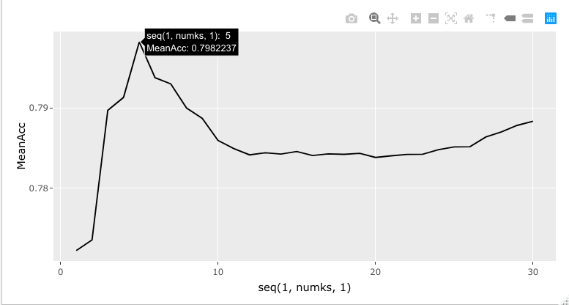
KNN Model Prediction
K=5 | Truly IPA | Truly Ale
Classified as IPA | 102 | 39
Classified as Ale | 54 | 270
Metric | Value
Accuracy | 79.35%
Sensitivity | 65.38%
Specificity | 86.38%
By shuffling test and training data 500 times, with K assigned from 1 to 30 during each shuffling, we can achieve the highest mean accuracy 79.8% when K=5.

Slide 13
Investigate ABV And IBU to Predict India Pale Ales and Other Styles of Ale by Naïve Bayes Model
 | Truly IPA | Truly Ale
Classified as IPA | 122 | 55
Classified as Ale | 47 | 241
Metric | Value
Accuracy | 79.40%
Sensitivity | 67.05%
Specificity | 86.66%
By shuffling test and training data 500 times, we can achieve the mean accuracy 79.4% when Naïve Bayes model was used.
Both KNN and Naïve Bayes models gave us the similar results by comparing two metric charts.

Slide 14
Budweiser Products Further Analysis
Let’s look at the current Budweiser beers in the market along with their ABV and IBU. Here is the list of Budweiser beers.
Budweiser - 5.0% ABV, 12 IBU.
Budweiser Nitro Gold – 5.0% ABV, 0 IBU
Budweiser Select – 4.3% ABV, 11 IBU
Budweiser Select 55 – 2.4% ABV, 0 IBU
Budweiser Chelada – 4.2% ABV, 0 IBU
Budweiser Zero – 0% ABV, 0 IBU
Well, let we look for a marketing strategy by using our beer data that we feel it will boost Budweiser’s revenue and profit.
It’s clear that Budweiser’s current beers in the market targets the people who love to drink low alcohol content and low bitterness beers.

Slide 15
Budweiser’s Market
We assume that the mean ABV and IBU in each state represent consumers’ tastes.
The states with low mean ABV and IBU are the ones that Budweiser should focus on.
From the graphics above, these states include Utah, Arkansas, Wisconsin and Wyoming.
If Budweiser wants to brew higher ABV and IBU beers in the future to expand the product line, Nevada, West Virginia and Idaho are top three states Budweiser can test their new beer.

